Slide 1
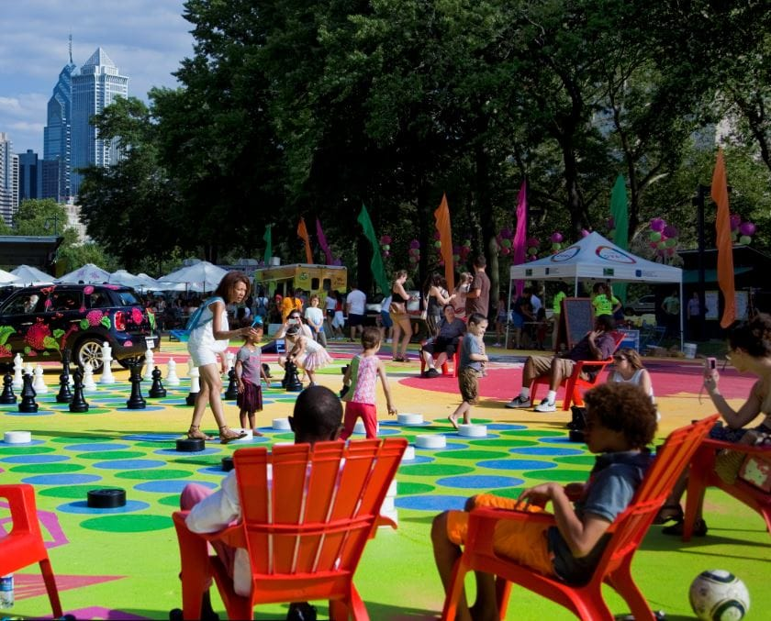
What is (Creative) Placemaking?

Slide 2
Have you heard….
Of this concept before?
If so – where?
If not – what does it lead you to think about?

Slide 3

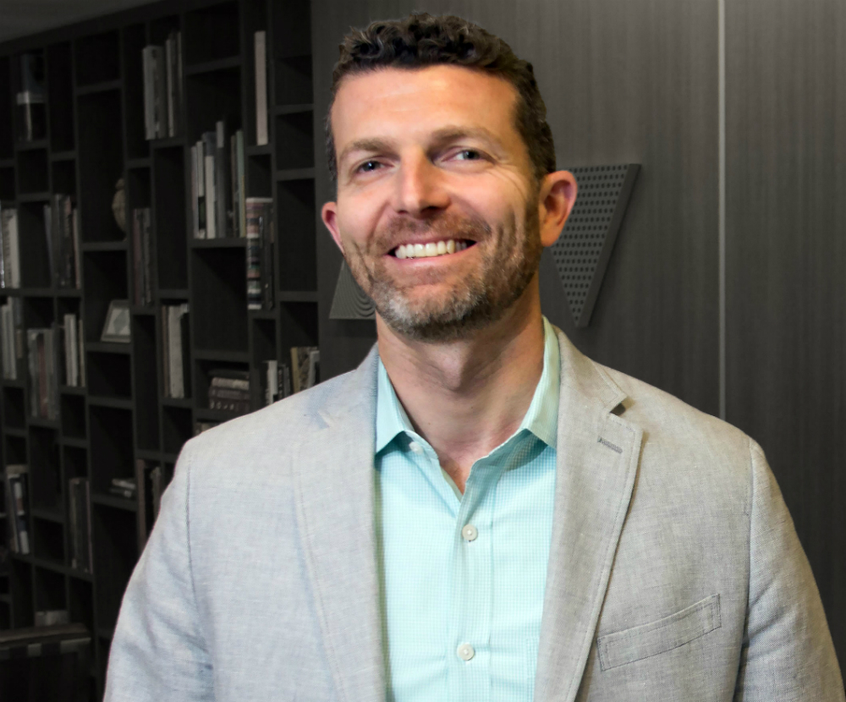
Jason Schupbach and the National Endowment of the Arts

Slide 4
To him….
It’s about artists and designers.
And helping them create their work.
But it’s also about “creative placemaking.”
How arts, culture, and “creative sector” make a community “a great place to live, work, and play.”
What to make of this?

Slide 5
When you “strategically involve”….
Arts, culture, and “creative industries.”
Leads to community development AND economic development.
How do you think that works?

Slide 6
Can take on different forms….
Based upon the needs of the community (keep this in mind).
Could be an arts district to help revitalize a downtown….

Slide 7
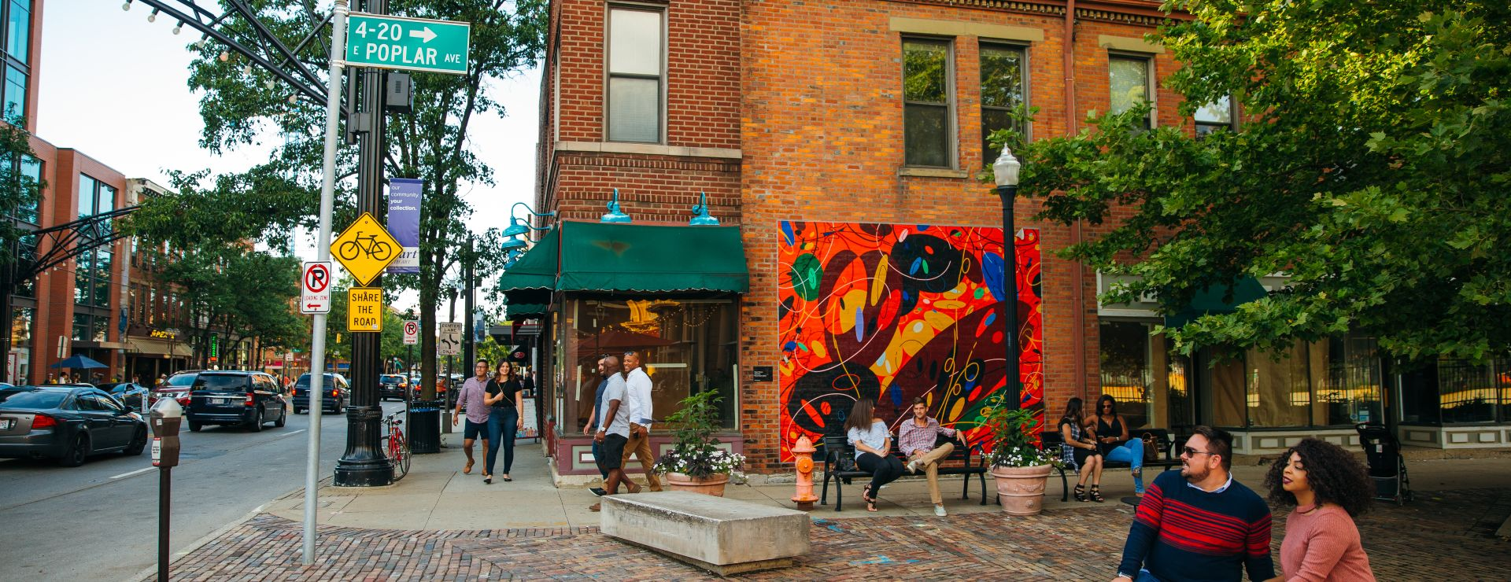
Short North Arts District (Columbus, OH)

Slide 8
Or…..
Adapting older structures into places where artists can “live, work, and play.”
Or public art….

Slide 9
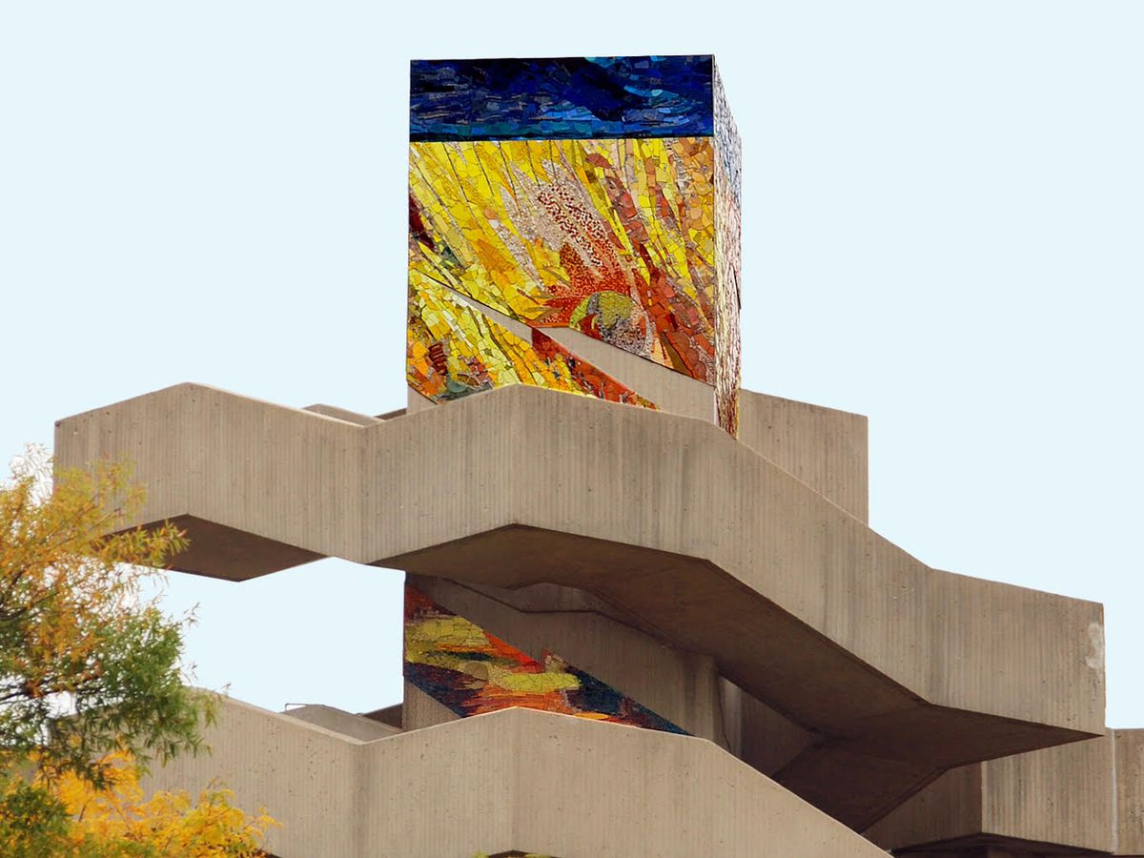
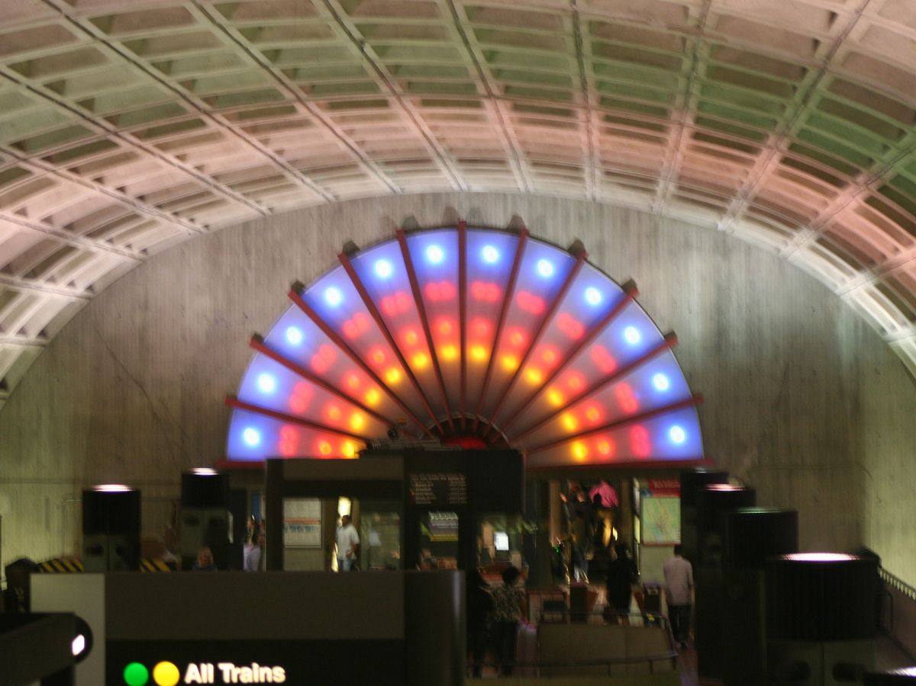
Washington, DC metro

Slide 10
Or by creating….
Film festivals.
Media centers.
Design industry centers.

Slide 11
What it will do?
Revitalize neighborhoods.
Grow jobs.
Grow private investment.
Bring together diverse groups of people in positive ways.

Slide 12
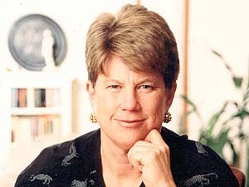
How about for Ann Markusen?

Slide 13
What she sees creative placemaking addressing….
Artistic creativity
Quality of life
Sustainability
Economic development

Slide 14
And the start of a definition….
When partners from public, non-profit, private, and community sectors join to strategically shape the physical and social character [of a place] around arts and cultural activity.
Arts and culture need to be embedded in place – what do you think that means?

Slide 15
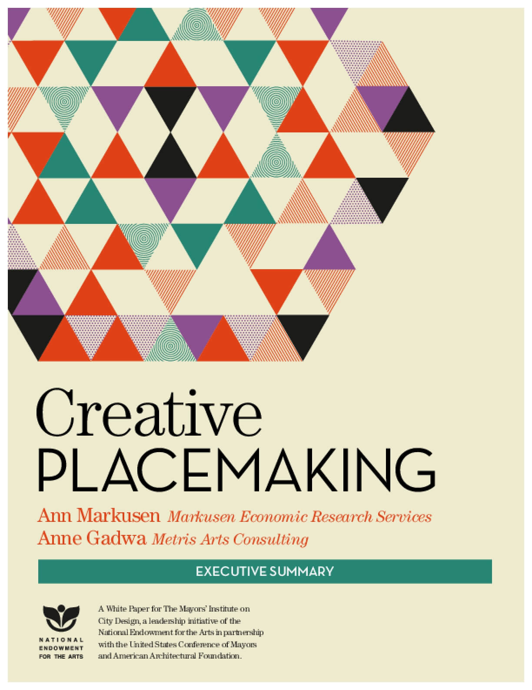
Picked 15 to highlight in this report….

Slide 16
This report identified 3 key ingredients in successful creative placemaking efforts….
Initiators
Distinctiveness and local orientation
Partnerships
What to make of any/all of these ingredients?

Slide 17
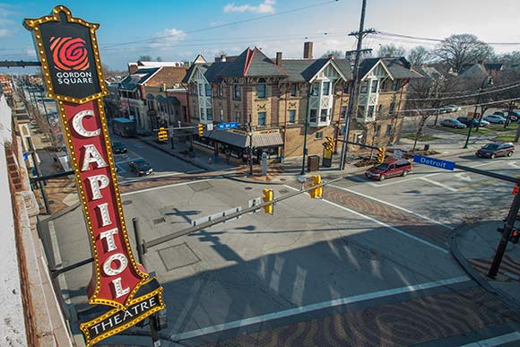
Gordon Square Arts District (Cleveland, OH)

Slide 18
And a discussion of outcomes….
Arts-infused placemaking does the following:
Animates public and private spaces
Brings diverse people together
Rejuvenates structures and streetscapes
Improves local business viability, community spirit, and public safety
Creates jobs and income within and beyond arts and culture industries
Nurtures artistic innovation and expands audiences for the arts

Slide 19
What is this trying to address?
And where did it come from?
Is there a history behind it?

Slide 20
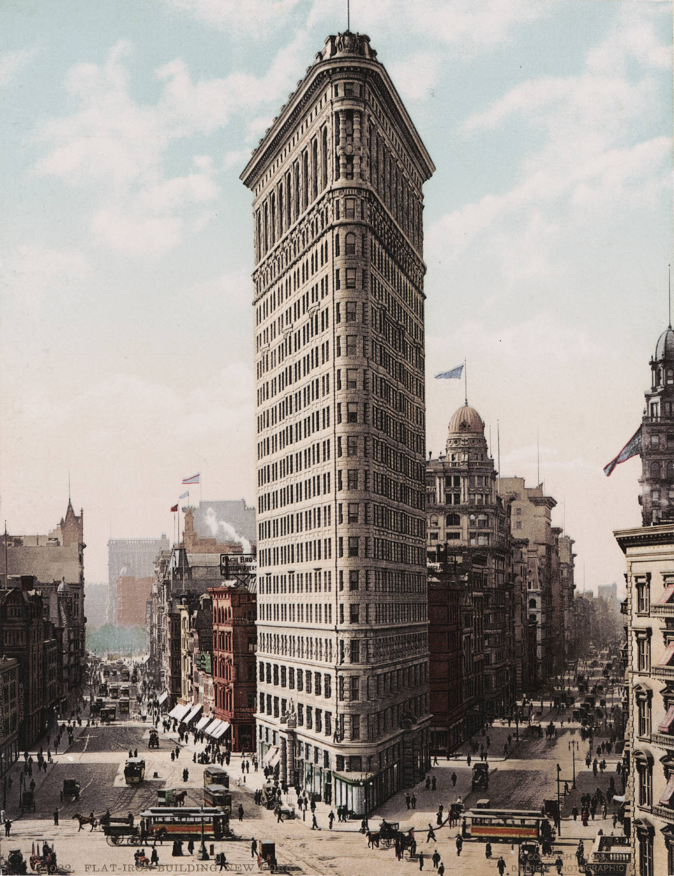
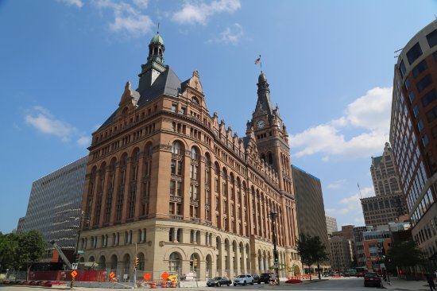
Cities and place…..

Slide 21
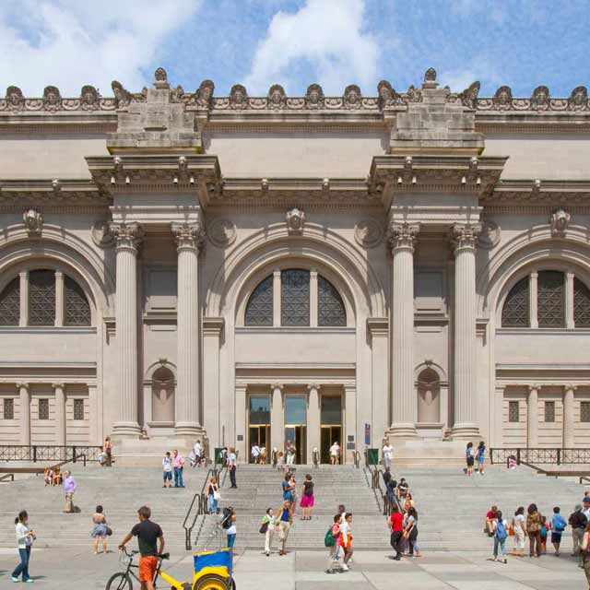
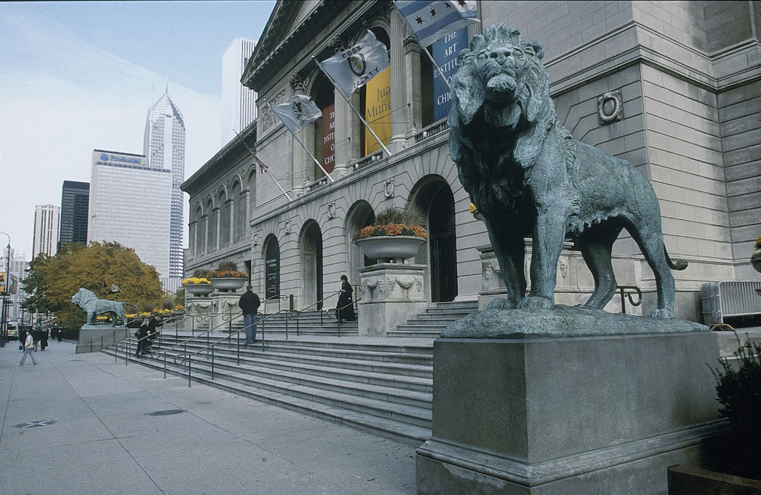
And art?

Slide 22
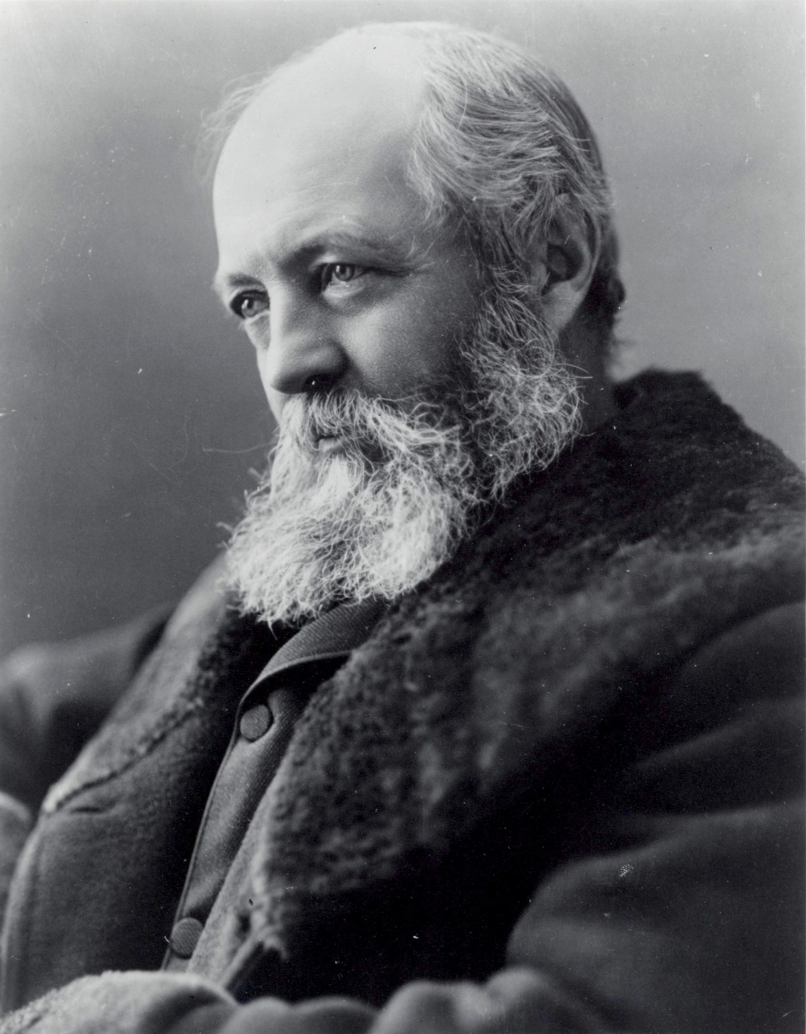
Frederick Law Olmsted

Slide 23
Olmsted
1822-1903
American landscape architect, journalist, social critic, and public administrator.
He created passages of scenery in which the visitor would become immersed, experiencing the restorative action of the landscape by what Olmsted termed an "unconscious" process.
Olmsted advanced social reform through park design – what he called “a democratic development of the highest significance.”
He believed access to nature was restorative and especially necessary for city dwellers. He wanted parks “to furnish healthful recreation for the poor and the rich, the young and the old…”
He fostered America’s public parks movement and established the foundations of urban planning – which helped make densely populated cities livable.

Slide 24
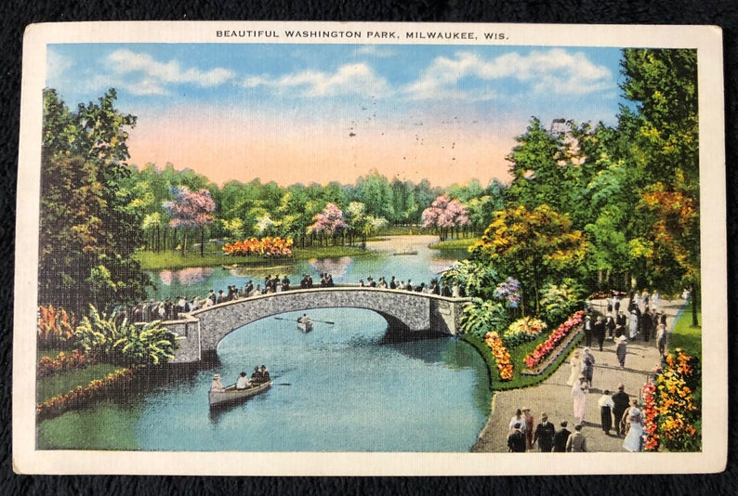
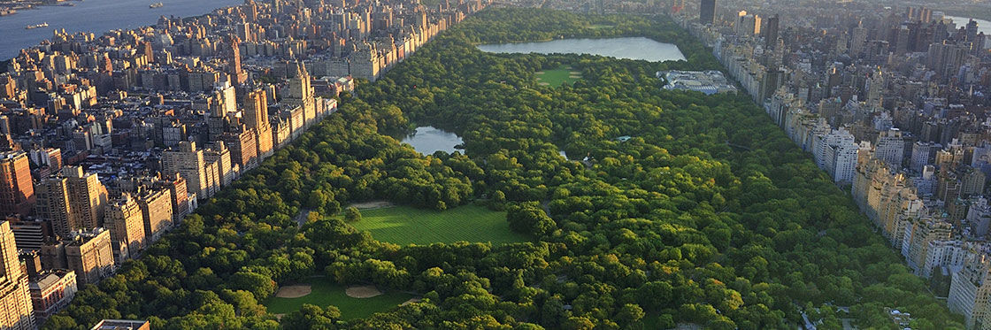
What this looked liked…..

Slide 25
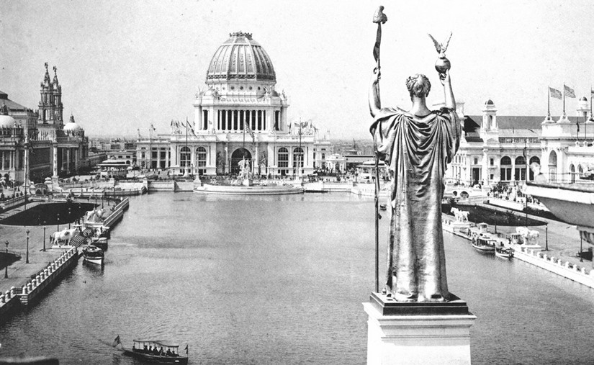
Into the City Beautiful Movement

Slide 26
In the 1890s and into the early 20th century….
A belief that aesthetic conditions of the city could impact behavior.
Attempts to use architecture, greenery, sculpture, and other tools to create “beautiful” urban environments.
In Milwaukee? Gardens.
In 1911, a Dr. N.A. Gray noted that Milwaukee was gaining a national reputation for such gardens. Gray told The Milwaukee Journal that, while on a trip to the East Coast, he heard “very favorable comment” on both his own garden – and on gardens throughout the city. “Milwaukee,” the paper concluded, “is getting a reputation for being the city beautiful with large, well kept gardens.”

Slide 27
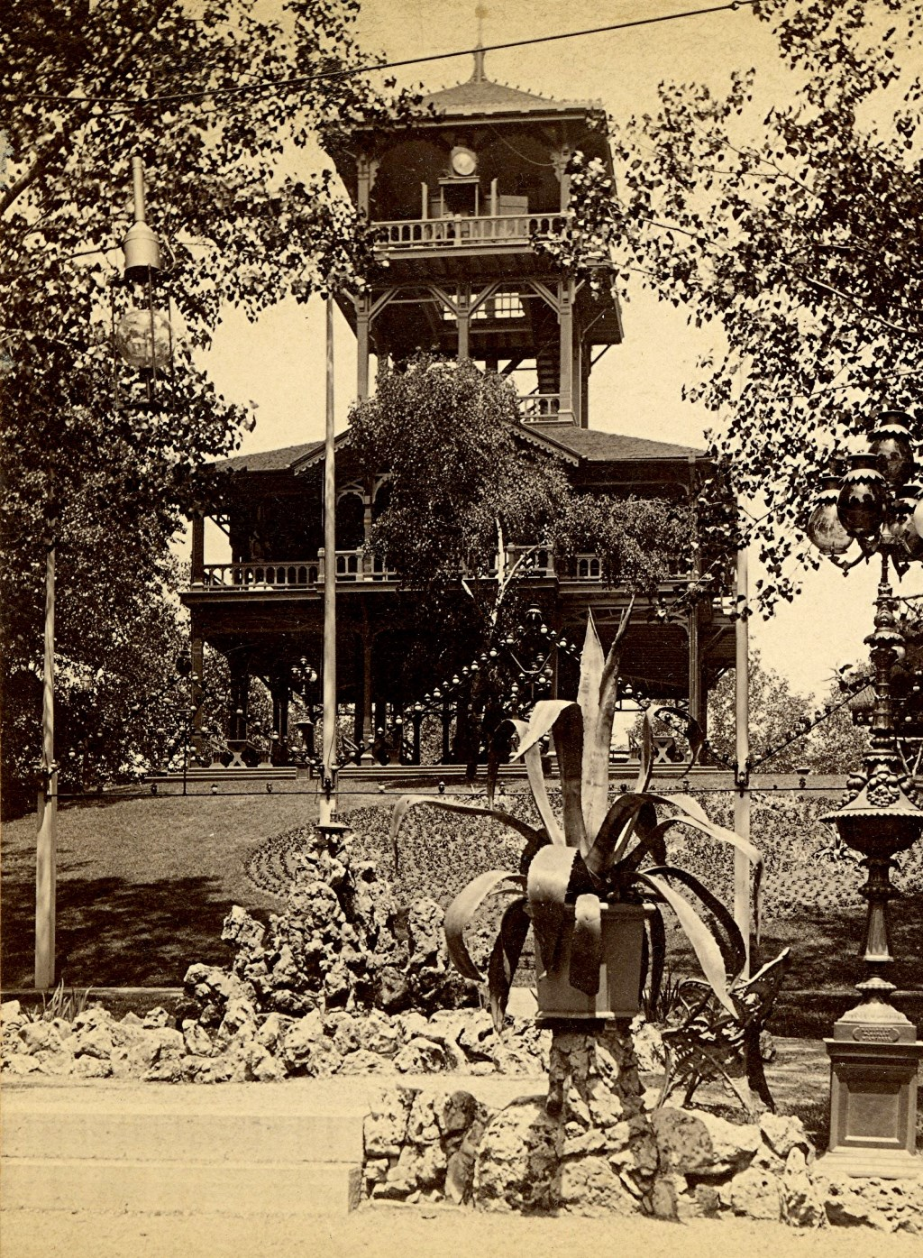
And beer gardens….

Slide 28
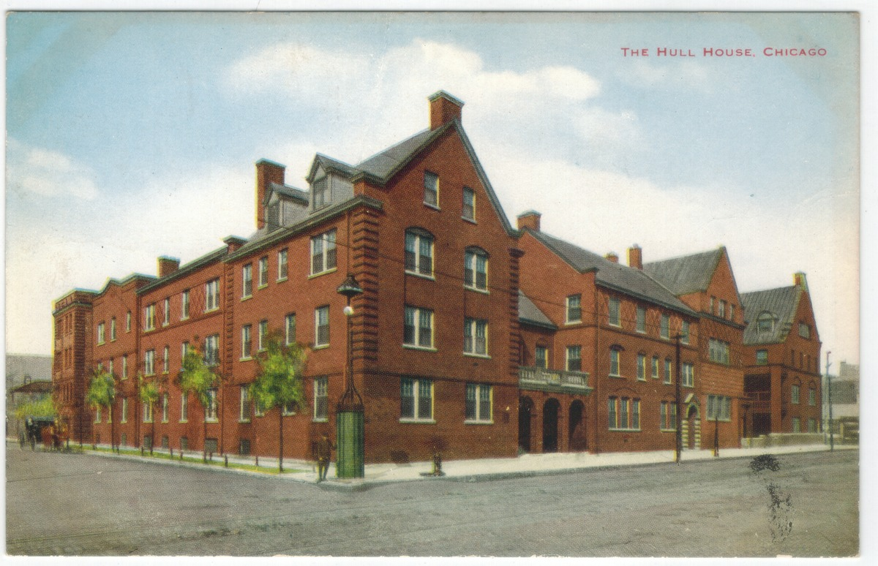
But more….

Slide 29
Hull House….
was a settlement house in the United States that was co-founded in 1889 by Jane Addams and Ellen Gates Starr.
Located on the Near West Side of Chicago, Illinois, Hull House was meant to assist recently arrived European immigrants.
By 1911, Hull House had grown to 13 buildings.
With its innovative social, educational, and artistic programs, Hull House became the standard bearer for the movement that had grown, by 1920, to almost 500 settlement houses nationally.

Slide 30
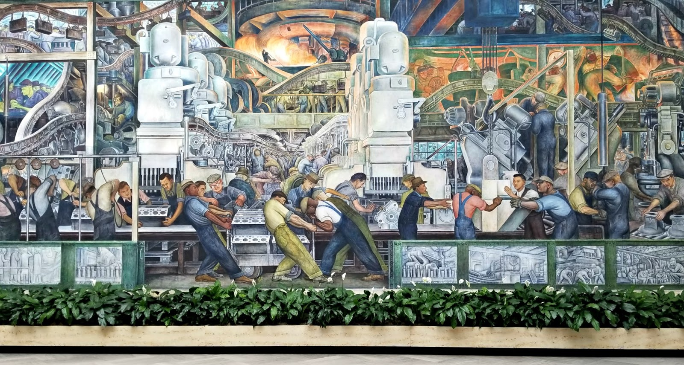
In the 1930s….

Slide 31
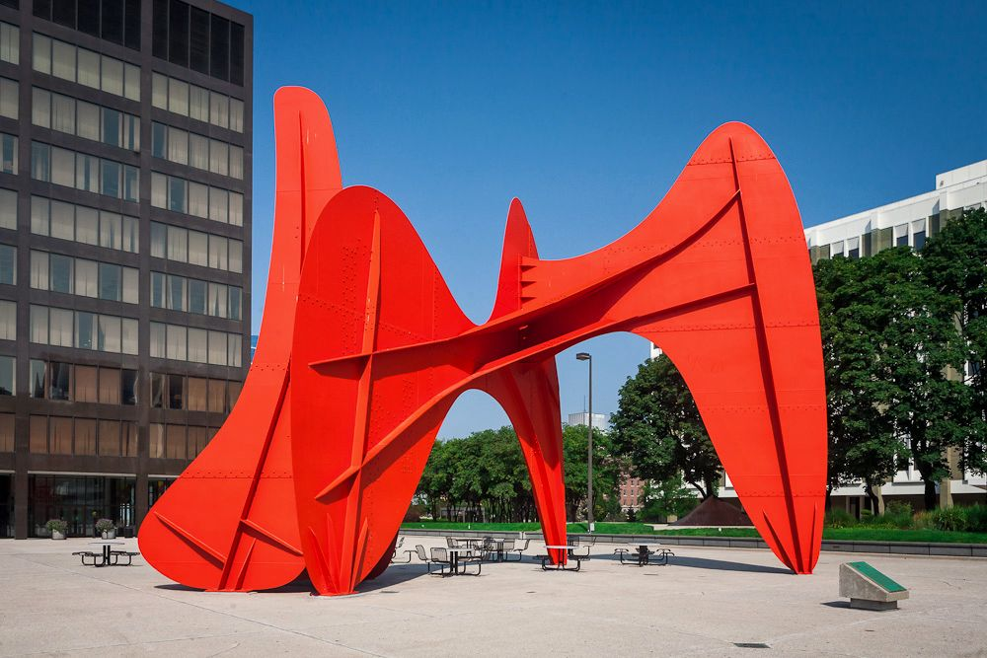
And into the 1960s….

Slide 32
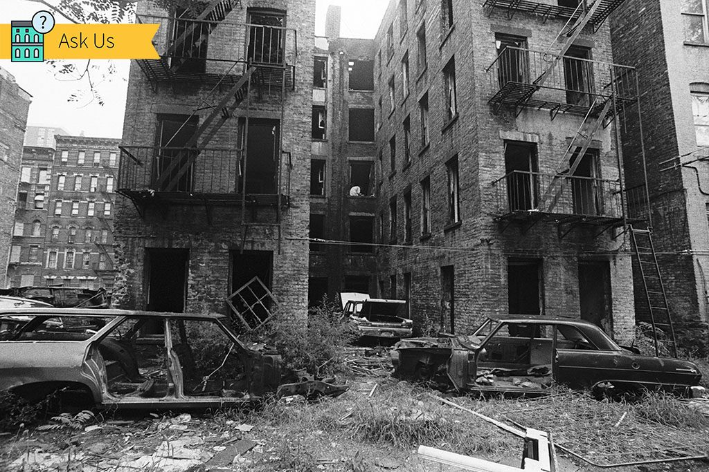
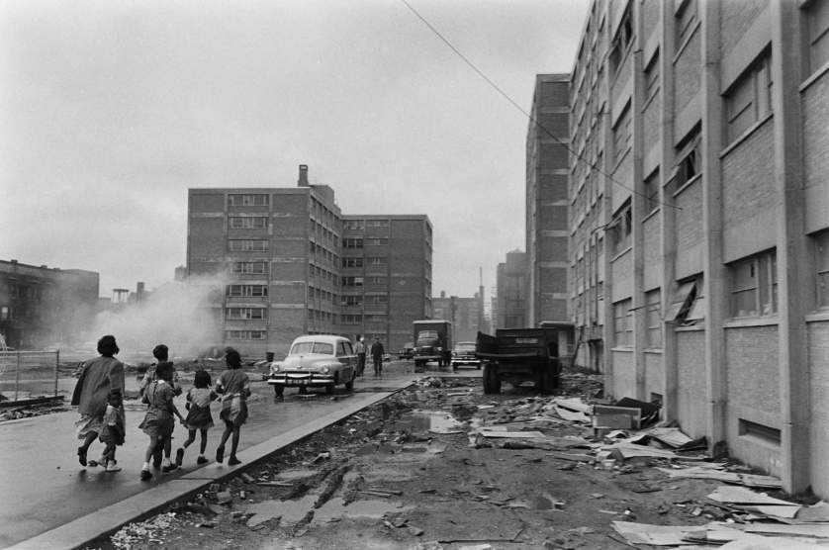
But into the 70s and 80s….

Slide 33
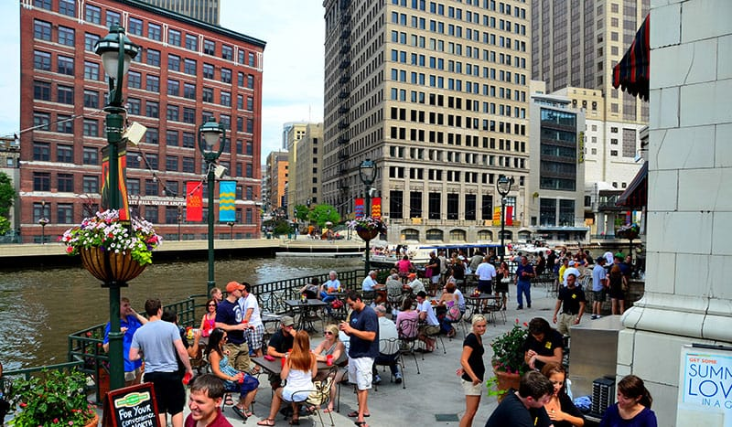
As cities realign in the 1990s….

Slide 34
These are the histories….
That creative placemaking is both building off of and attempting to address.
Aesthetics and planning
Economy
Arts
Individual
Community

Slide 35
What….
Do you think of this concept of creative placemaking so far?
Strengths?
Weaknesses?
Anything we are overlooking?

